Slide 1
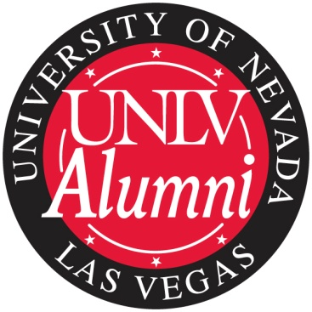
About the Alumni Association
UNLV Alumni Association
Leadership Development Day
March 3, 2012

Slide 2
UNLV Alumni Association
Began in 1968
Represent 100,000 alumni with 64% in Southern Nevada
2,482 “active” members
7 academic chapters, more in the works
Student Alumni Association
16 regional clubs
Promote a strong relationship between alumni and the university community
Provide volunteer leadership, support and other resources for UNLV and the association

Slide 3
Vision
We are a leader in:
  Connecting alumni for life to UNLV
  Communicating UNLV news to alumni
  Networking for alumni, students, and prospective students

Slide 4
Structure
Volunteer Leaders
  Board of Directors (26 members)
  Committees
  College-based Chapters (7 chapters)
  Student Alumni Association
  Regional & Affinity Clubs (16 clubs)
University –Paid Leaders
  University Advancement
  Alumni Relations (5.5 FTE)
  Chapter Liaisons

Slide 5
Working Together To Engage Alumni
Advocacy
Communications
Events
Membership
Student Programs
Community Outreach
Leadership Development

